Slide 1
Maths
Year 7
Spring 1
Vocabulary Wheel
Science
Reciprocal
English
Equivalent
Abundance
Severe
Convert
Inverse
Molten
Chaos
Conjugate
Lustrous
Establish
Resolve
Approximate
Deceive
Resolution
Intersection
Replenish
Obsession
Command
Saturated
Influence
Estimate
Crude
Conflict
Conflict
Union
Activism
Perspective
Mock
Skew
Ascend
Corruption
Art
Infer
Exonerate
Democracy
Drama
Idolatry
Oppression
Worship
Dimensions
Justify
Tolerance
Construct
Interpret
Equality
Liberation
Convincing
Compose
Symmetry
Consequence
Proportional
Authority
Perspective
Prototype
Effects
Insinuate
Inevitable
Aesthetics
Legitimate
Discriminate
Iterative
Manufacturing
Dynamic
Causes
Inequality
Contextualize
Functionality
Tactical
Elite
Properties
Individual
Agriculture
Symbolize
History
Fabricate
Participate
Exploitation
Persuade
Automation
Design Technology
Effectiveness
Co-ordinate
Development
Endurance
Interdependent
Fundamental
Characteristics
Collaborate
Distribution
Competitive
Geography
Physical Education
Notes:
5 ideas of how to use this!

Slide 2
Understanding how these words work across our subjects will help students master vocabulary quicker.
Does the function of the word mean the same in every subject? Be sure to continue working with what words mean in your subject.
How many different words do we use that have the same meaning but students may not know this? Synonyms.
Caution: some synonyms might mean something similar but have a slightly different connotation or meaning. So be careful what answer you accept from students when they do not use the exact definition you have given them.

Slide 3
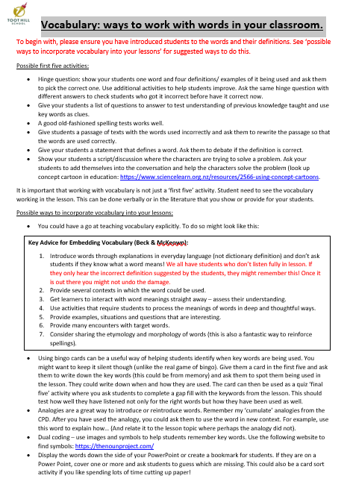
Vocabulary: ways to work with words in your classroom.
Five key ideas:
Hinge question: show your students one word and four definitions/ examples of it being used and ask them to pick the correct one. Use additional activities to help students improve. Ask the same hinge question with different answers to check students who got it incorrect before have it correct now.
Analogies are a great way to introduce or reintroduce words. Remember my ‘cumulate’ analogies from the CPD. After you have used the analogy, you could ask them to use the word in new context. For example, use this word to explain how… (And relate it to the lesson topic where perhaps the analogy did not).
It is important to keep reinforcing the right answer and do not accept ‘kind of right’ answers. If you have given students the definitions of the key words, expect them to use these definitions when asked what they mean. Don’t except anything other than accuracy.
Ask students to complete a written task. Write a model answer that includes the key vocabulary and use this as a checklist. Have the students used the same vocabulary as you? They can use a purple pen to tick the words and then make improvements using the words that they have missed.
This can also be a great way to discuss how to use words accurately and what they mean by using your model as the example.
Give vocabulary based homework.
For more information read:

