Slide 1



Slide 2

Special Educational Needs and Disabilities at Toot Hill School
Mrs Rachel Brentley – SENDCO
Louise Norton – SEND Governor
Helen Holmes – District SENDCO for Rushcliffe
The SEND department
Supporting SEND students at Toot Hill School
Transition and preparing for year 7

Slide 3
Structure of SEND Department 24-25
Mrs Brentley
(SENDCO)
Miss Warren
(Asst. SENDCO)
Mrs Lord
Yr 7
Mrs Lang
(HLTA/ADHD)
Mr Collen (Asst. SENDCO)
Mrs Wood and Mrs Regan
(Mental Health and Wellbeing)
Mrs Bowry
(Access Arrangement Assessor)
Mrs Hasekili
(HLTA/Dyslexia)
Mrs Baker
Yr7/8
Mrs Pavlova
Yr 8
Mrs Hazeldine
Yr 8
Mrs Tkachenko
Yr 9
Mrs Hall
Wellbeing Mentor
Mrs Lowe
Yr 10
Mrs Cleland
Yr 11
Mrs Patrick
Yr 7/12/13
Mrs Patrick
Yr 12/13
Mrs Greasely
(HLTA/ASC)
Mrs Lok
Yr 8

Slide 4
The Transition Process
Option A | Option B | Option C | Option D
Some students with complex needs including EHCPs start this process in year 5, visiting around once a half term / term. Initial visits are with the SENDCO | Some students begin visits with parents / external agencies ie: Educational Psychologist at the beginning of year 6. These visits are with the SENDCO | Transition Co-Ordinator (Mrs Lang) liaises with the Primary School SENDCO. Some SEND students are invited in to Toot Hill for additional transition visits in Half Term 6. Students in Option A and Option B will be invited | All students attend the Transition Day in July
All SENDCOs in the Primary School meet with the SENDCO and/or Asst. SENDCO at Toot Hill School for a full handover of information.

Slide 5
The presentation is for all students that are on the SEND register and the Monitor (Concerns/Vulnerable) List
If your child is on the Monitor List– we monitor them to ensure they are making progress. Students on the Monitor require little or no support from the SEND department and make progress through Quality First Teaching and/or reasonable adjustments.
For M students your first point of contact will be the form tutor. All teaching staff are aware of any needs/adjustments.
If your child is on the SEND register they will have:
  A key worker – they will make contact early September
  A Pupil Profile – to be shared with all teaching staff
WAVE 3
Students with the most complex needs, funded and EHCP

Slide 6
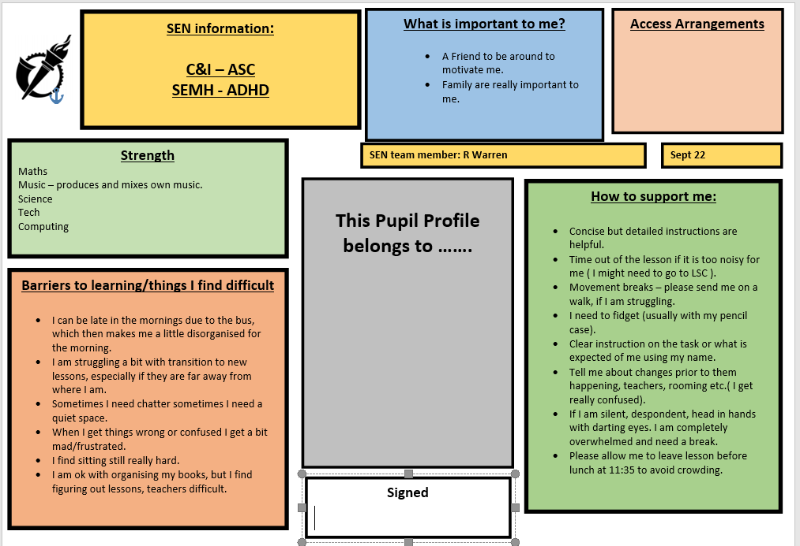

Slide 7
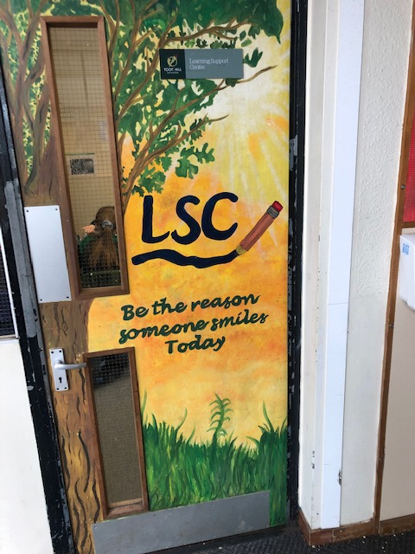
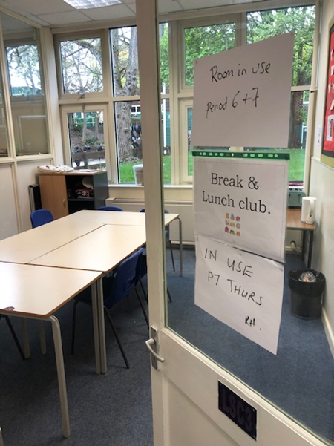
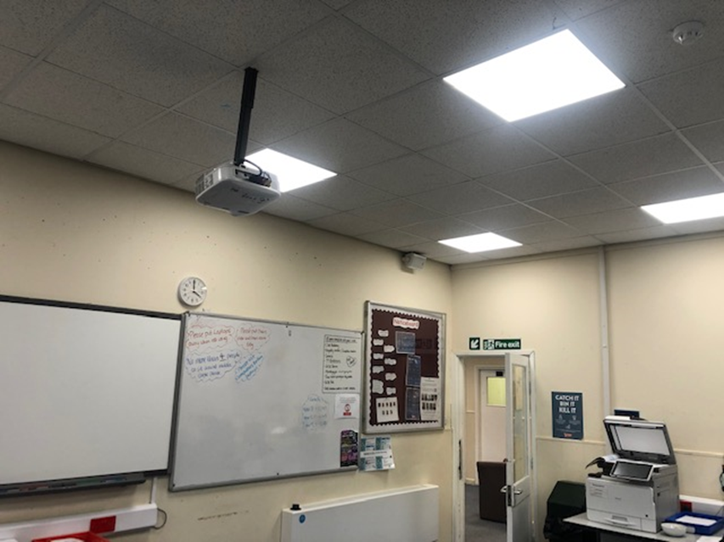
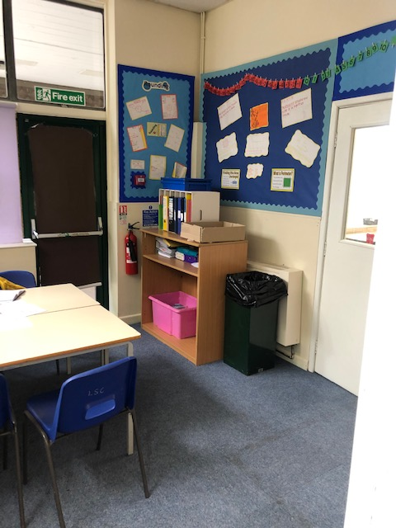
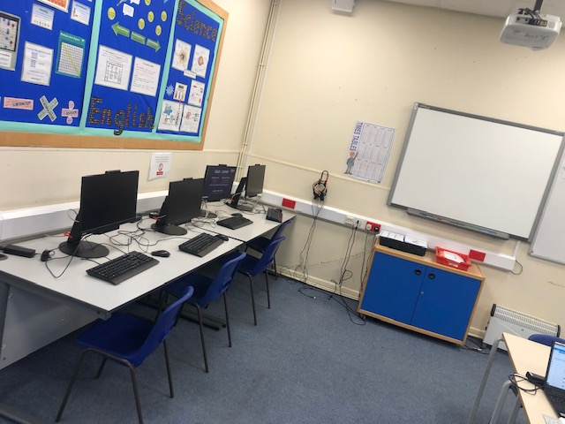
Learning Support Centre (LSC)
Sensory Room (L5)
Lunch club/break club
Tea and Toast
Time out
Den
Interventions
A member of staff on duty
Homework Club

Slide 8

Screening and Access Arrangements
Screening
Mrs Baker arranges for ALL year 7 students to be screened for Literacy in September. If your child requires further support with literacy Mrs Hasekili(C&L HLTA) will make contact.
The screener will look at Comprehension, Spelling and Reading and where difficulties have been identified the appropriate intervention will be put in place.
Access Arrangements
Students are formally screened at the end of year 9/beginning of year 10 for Access Arrangements for GCSEs, this is formal process with a qualified assessor (Mrs Bowry)

Slide 9

The Hub
Mental Health and Wellbeing
The Hub is the area where support for Mental Health is delivered
Support includes workshops and counselling sessions delivered Mental Health Lead Mrs Wood and Mrs Regan and the Wellbeing Mentor (Mrs Hall) and external agencies such as Casy Counselling, CAMHS and Health Families Team
Primary schools have identified anxious leaners and will be invited to attend ‘worry workshops’ in September.

Slide 10
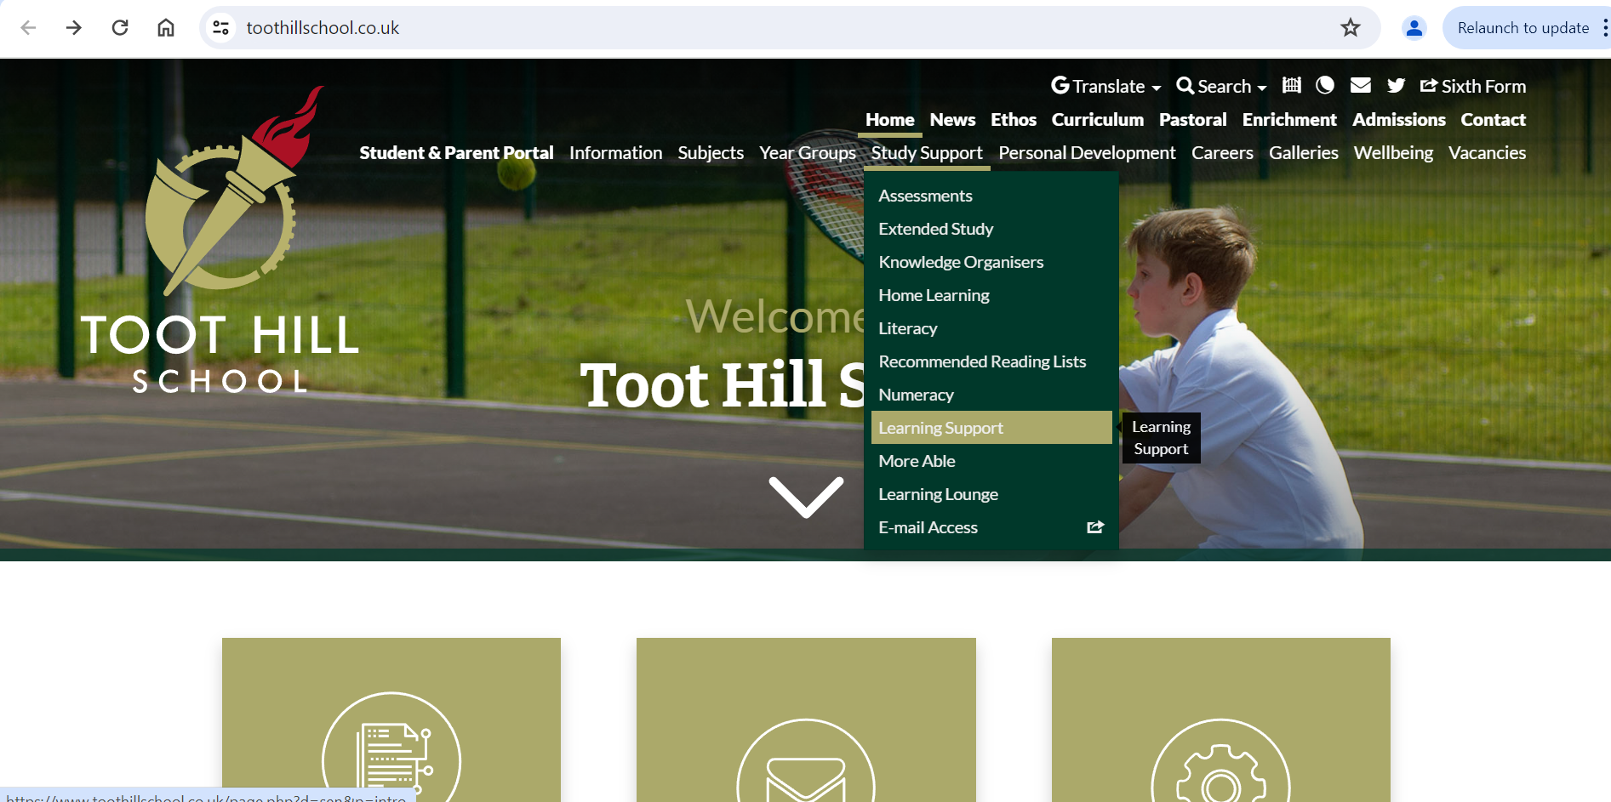
Further information
Mrs Brentley – SENDCO – rbrentley@toothillschool.co.uk
Key worker – they will be in touch summer term or INSET days in August
School website* - www.toothillschool.co.uk

Slide 11
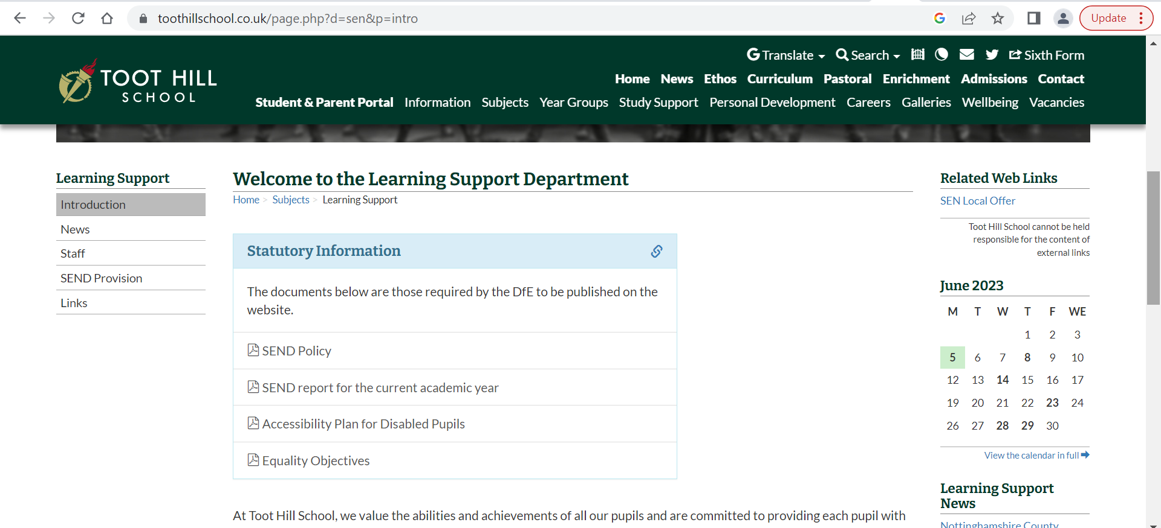
* We are looking at improving this area of the school website!

Slide 12

Mrs Brentley – SENDCO – rbrentley@toothillschool.co.uk
Key worker – they will be in touch early September
School website - www.toothillschool.co.uk

