Slide 1
Starter - Complete the Section:
Debit cards and Credit Card
What is a debit card?
A plastic card that provides the cardholder electronic access to his / her bank account.
What is it used for? Write 2 things
Pay for goods without using cash; buy items online
Get "cash back“; get money out of ATMs
What is a credit card?
A plastic card that allows the cardholder to borrow money from the credit card company.
What is it used for? Write 2 things
Pay for goods without using cash; buy items online
Withdraw cash
What are the features of a credit card? Write 2 things
Buy now pay later
Have a month to pay back interest free

Slide 2
Complete the questions: Needs, Wants and Budget
What is a need? Can you give examples?
Basic items that are essential to a person’s survival.
Examples: shelter; food; water.
What is a want? Can you give examples?
Items that are nice to have.
Examples: holidays; PS4; iPad; make up
What is a budget?
A budget is a way of dividing up your money and deciding what to do with it.
Why would a person manage their money? Write 2 things
Pay monthly bills
Save for an expensive item
Avoid debts
Manage debts

Slide 3
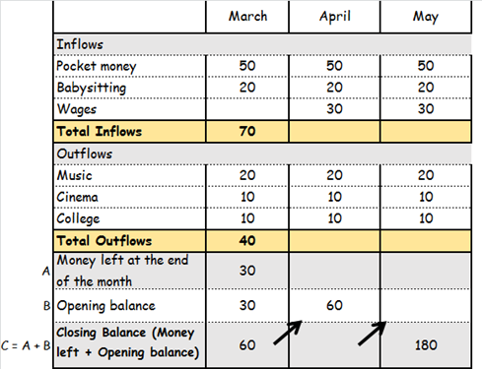
Complete the questions: Jess’ Budget
100
100
40
40
60
60
120
120

Slide 4
Complete the questions: Work
What is full time work?
Where a worker works the maximum number of hours required for a full working week.
What is part time work?
Where the number of hours someone works is less than a full time working week.
What is seasonal work?
Where jobs depend on the time of year.

Slide 5
Complete the questions: Wage slip
What is a wage slip?
A document showing wages paid and deductions made.
What is deducted from people’s pay?
Tax
National insurance
Trade union fees
Company pension contributions
Why is money deducted from people’s pay?
Tax: to pay for schools; hospitals; police…
National insurance: to pay into future pension scheme

Slide 6
Complete the questions: Pay
What is gross pay?
Total pay received from working before any deductions
What is net pay?
Net pay = Gross pay - Deductions
Can you calculate gross and net pay?
40 hours @ £3 = £120
10 hours @ £5 = £50
Gross pay = £120 + £50 = £170
Net pay = £170 – income tax – Nat. Ins
= £170 - £60
= £110

Slide 7
Complete the questions: Debit cards and Credit Card
What are the features of a credit card? Write 2 things
Buy now pay later
Have a month to pay back interest free
After that interest is put on top
Can pay off in instalments, but interest charged
Can take advantage of free interest periods

